Slide 1
University Registrar
DR LULAMILE NTONZIMA

Slide 2
Biograph
Dr Lulamile Ntonzima, WSU Registrar
Graduated Master’s degree and PhD at Cape Peninsular University of Technology (CPUT) and worked at CPUT as a Lecturer, Senior Lecturer, and Faculty Manager. Worked for University of Pretoria as a Deputy Director: Higher Education Monitoring and Evaluation. Currently works for WSU and held the following positions: Director: Strategic Projects in the Office of the Vice-Chancellor and Principal, Campus Rector, and Senior Director: Campus Support. Now holds the position of the University Registrar. A member of various company boards. Published a book, academic articles and presented academic papers at international and international conferences.

Slide 3
Topic
Optimising Student Experience: Leveraging Data-Driven Approaches for Enhanced Academic Outcomes and Engagement

Slide 4
Optimising Student Experience
Student Experience and Legal Framework in South Africa
Optimising Student Experience: Front 01
Optimising Student Experience: Front 02
Mega Multi-Million Projects : These Cannot Fail
Optimizing Student Experience: Leveraging Data-Driven Approaches for Enhanced Academic Outcomes and Engagement
Presentation Focus:

Slide 5
The presentation underscores the critical importance of the student experience in higher education, elucidating its multifaceted impact on academic performance and institutional reputation.
Optimising Student Experience: Front 01

Slide 6
The presentation explores the transformative potential of data-driven approaches in bolstering student support services and elevating overall institutional performance, thus paving the way for a future of enriched student experiences and academic excellence.
Optimising Student Experience: Front 02

Slide 7
The student experience stands as a cornerstone of contemporary higher education, exerting profound influence on engagement, satisfaction, and academic performance. Recognising its pivotal role, academic institutions are continuously seeking avenues for enhancement.
Understanding Student Experience

Slide 8
1. Framework for Qualification Standards in Higher Education, 2023
QSs are used to guide the design of new programmes and review of the existing ones.
QSs assist institutions in their relations with professional bodies, employers, and the public.
QSs guide institutions when evaluating the national and international comparability of their own qualifications.
Student Experience and Legal Framework in South Africa

Slide 9
2. Norms of Certification for the Higher Education Sector within the Context of
the Higher Education Qualifications Sub-Framework, 2020
The norms articulate principles, rules and practices that foster and enhance the credibility, integrity, reliability and validity of the systems and processes for conferring qualifications and issuing certificates.
Student Experience and Legal Framework in South Africa

Slide 10
3. National Qualifications Framework Act (Act No. 67 of 2008
as amended)- governs the further development, organisation and governance of the National Qualifications Framework (NQF) as a single integrated national framework for learning achievements.
This Act designates the Council on Higher Education (CHE) as the Quality Council (QC) for higher education. Sections 5(3) (b) and (c) of the same Act mandate the CHE, as the QC for higher education, to work collaboratively with the South African Qualifications Authority (SAQA) to ensure that the higher education qualifications conferred by institutions in the country meet appropriate criteria, are of acceptable quality and are also internationally comparable.
Student Experience and Legal Framework in South Africa

Slide 11
The presentation underscores the critical importance of the student experience in higher education, elucidating its multifaceted impact on academic performance and institutional reputation.
This points to:
Established culture of good practices (early warning system)
Solidified graduates attributes
Good pass rates
Solid alumni relations
Industry confidence
Public confidence
This points to data evidence – predictive credibility
Optimising Student Experience: Front 01

Slide 12
The presentation explores the transformative potential of data-driven approaches in bolstering student support services and elevating overall institutional performance, thus paving the way for a future of enriched student experiences and academic excellence.
CASE STUDY AND DATA-DRIVE APPROACH
Optimising Student Experience: Front 02

Slide 13
Rationalisation of Faculties and Campus Consolidation – massive data-driven strategy
Case Study 01

Slide 14
R&C Project and Data Handled
Case Study 01
Numbers by Milestone | Data Handled
Implement New Faculty- and Department Structures | 1 593 000 Records
Implement New Finance Cost Centre Structure | 12 399 000 Records
Implement New Human Resources- and Post Structure | 6 710 Records
Implement New Set of Qualifications | 189 New Qualifications
Implement New Set of Subjects | 2330 New Subjects

Slide 15
R&C Project and Data Handled:
HR & Space System Records
2.7 million updates were done to HR-, Payroll- and Space System records. This was between May 2023 – November 2023
Finance
12.9 million updates were done to Finance- and Budgeting System records.
This included updates on Tuition Fee Structure and Student Accounts records.
Case Study 01

Slide 16
R&C Project and Data Handled:
Academic Structure
0.9 million updates were done in respect of the Academic Structure before year 2024.
For year 2024 a completely new Academic Structure was designed and created with 189 Qualifications, 2 330 Subjects across 4 Campuses and 12 Offering Types.
Case Study 01

Slide 17
R&C Project and Data Handled:
Rationalised Faculties & Student Enrolment - 2024
Up to 27 Feb 2024, a total of 27 664 students registered - 18 961 were returning students from 2023 and
8703 were FTENs and transfer students.
Case Study 01

Slide 18
Integrity Project and Data Handled:
Rationalised Faculties & Student Enrolment - 2024
Up to 27 Feb 2024, a total of 27 664 students registered - 18 961 were returning students from 2023 and
8703 were FTENs and transfer students.
Case Study 02

Slide 19
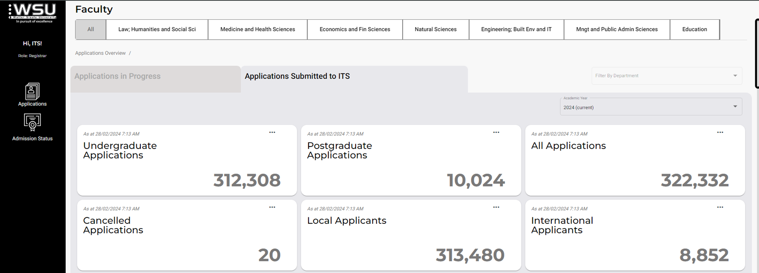
Integrity Project and Data Handled: Infinity – The Flagship Project
Case Study 02

Slide 20
Integrity Project and Data Handled: Infinity – The Flagship Project
Case Study 02

Slide 21
Integrity Project and Data Handled: Infinity – The Flagship Project
Case Study 02

Slide 22
Integrity Project and Data Handled: Infinity – The Flagship Project
Case Study 02

Slide 23
Integrity Project and Data Handled: Infinity – The Flagship Project
Case Study 02

Slide 24
Integrity Project and Data Handled: High Impact Projects
Lecturer I-Enabler
Auto Graduate Identifier
Auto Promotion
Auto Exclusion
ITS Generated Certification
CELCAT Timetables
Case Study 02

Slide 25
Critical Enablers
Linear Project Plan
Defined Project Outcomes
Trusted Partnership
Mandatory Presence
Executive Leadership
Inevitables – Confront & Fight
Loosing friends
Litigations
Mega Multi Million Project : These Cannot Fail

Slide 26
System Integration
Data Quality
Data Reliability
Integrated reporting
Vision Affirmation
Strategy Execution
Organisation Performance
Enhanced Student Experience
Leveraging Data-Driven Approaches for Enhanced Academic Outcomes and Engagement

Slide 27
ENKOSI

